Slide 1
Research Corner

Slide 2
Research Corner
In this activity, you will work in groups to explore a topic that connects Artificial Intelligence (AI) with Software Engineering.
Your task is to investigate the chosen topic, understand its relevance, and present your findings in a 15-minute presentation.
This activity is designed to enhance your understanding of AI's applications in software engineering, foster collaborative learning, and improve your presentation skills.

Slide 3
Steps
Choose a Topic: Each group will select a topic that intersects AI and software engineering.
Conduct Research: Once your topic is selected, gather information from academic papers, case studies, and relevant sources. Identify real-world examples where AI has been applied in software engineering.
Prepare a Presentation: Based on your research, prepare a 15-minute presentation. Your presentation should:
  Introduce the topic clearly
  Explain the core concepts of AI related to your topic
  Demonstrate how AI is applied in software engineering
  Provide examples, case studies, or practical applications
  Engage your audience with visuals and examples where possible
Online Presentation: Your group will deliver the presentation during a designated class session.

Slide 4

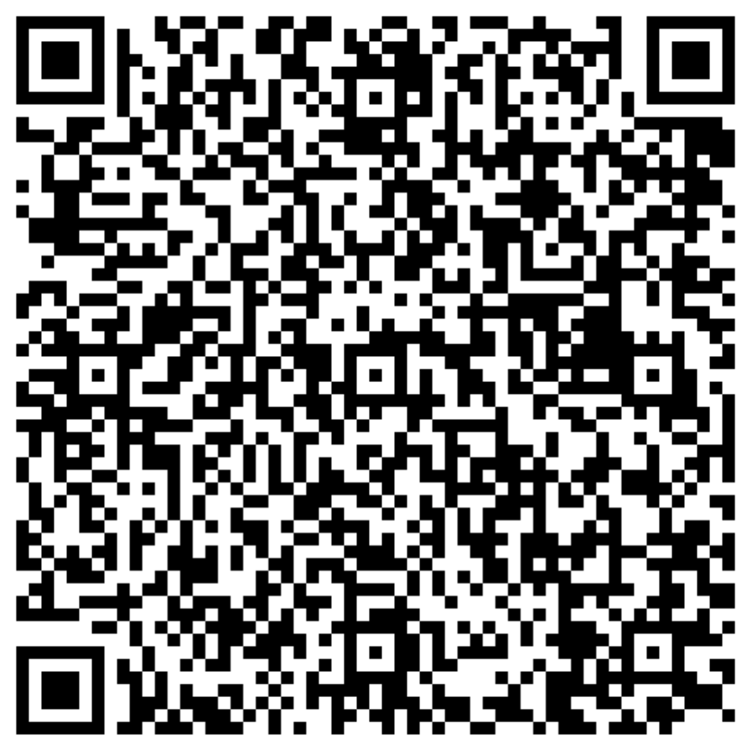

Activity Description
Deadline: see your specific date.
Deliverable:
Talk
Slides submitted on canvas.

Slide 5
Topics, Groups and Dates
Topic | Group (still missing 8, 11, 19, 21, 22) | Date
AI applied to code review |  | Nov 10
Software Fairness | Group 20 | Nov 10
Conversational Agents and Chatbots for Software Teams |  | Nov 10
AI applied to software refactoring |  | Nov 12
Agentic AI | Group 15 | Nov 12
AI-Driven Software Analytics and Technical Debt Management | Group 26 | Nov 12
AI applied to Automated Code Generation | Group 16 | Nov 14
Software Fairness | Group 9 | Nov 14
AI for Developer Productivity and Knowledge Transfer |  | Nov 14
AI applied to software architecture | Group 2 | Nov 17
AI applied to software design | Group 25 | Nov 17
AI applied to software design | Group 1 | Nov 17

Slide 6
Topics, Groups and Dates
Topic | Group | Date
AI applied to software design | Group 5 | Nov 19
AI applied to Test Case Generation | Group 12 | Nov 19
Agentic AI | Group 24 | Nov 19
AI applied to Code Review Automation | Group 4 | Nov 21
AI applied to software refactoring | Group 23 | Nov 21
AI applied to Code Smell Detection | Group 18 | Nov 21
AI applied to Security Vulnerability Detection | Group 10 | Dec 01
AI applied to Automated Documentation Generation |  | Dec 01
AI applied to Test Case Generation | Group 14 | Dec 01
AI applied to Code Review Automation | Group 13 | Dec 03
Adaptive Project Management and Effort Estimation | Group 17 | Dec 03
AI for Developer Productivity and Knowledge Transfer | Group 7 | Dec 03

Slide 7
Topics, Groups and Dates
Topic | Group | Date
AI applied to Automated Code Generation | Group 6 | Dec 05
AI-Driven Software Analytics and Technical Debt Management |  | Dec 05
AI applied to requirements specification | Group 3 | Dec 05

Slide 8
Evaluation Criteria
Content (40%): Depth of research, accuracy of information, and relevance to the chosen topic. The presentation should demonstrate a clear understanding of the relationship between AI and software engineering.
Clarity and Organization (30%): The presentation should be well-organized, with a logical flow of ideas, clear explanations, and easy-to-follow examples.
Examples and Practicality (20%): Use of real-world examples or case studies to support your points. Demonstrating practical applications of AI in software engineering is essential.
Team Collaboration (10%): All group members should contribute to the research and presentation. Collaboration will be assessed based on the seamlessness of transitions and the balance of contributions during the presentation.

Slide 9
Research Corner

